Slide 1
Libros for Oregon: Collections Connect Communities
An LSTA grant to support Spanish-language collection development in Oregon libraries
Deborah Gitlitz, Outreach Librarian
Wilsonville Library
Notes:
BRING:
Presentation on laptop & USB
Presentation, printed
Books
FIL catalog
Printout of working docs
Photos printed out?
Business cards

Slide 2
Background: The Conversation(s)
The perennial challenge: Acquiring good books in Spanish for our libraries!
Materials reflecting and honoring the experiences of people in our service populations
Written originally in Spanish
Formats suitable for libraries
Available for purchase
Fall of 2015: Oregon library listserv discussion
Not enough satisfactory resources yet in the US
Challenges of sending staff to the important Guadalajara book fair
  biggest Spanish-language book fair in the world
  2017 = 31st year
  More about this later
California library book-buying collaborative?
Why couldn’t we do that in a way that would benefit all of Oregon?

Slide 3
Applying for the Grant
Listserv conversation: late fall 2015
January 2016: gathered listserv conversation participants
  OLA & REFORMA Oregon members, Katie Anderson, et al.
Hustle!
  Letters of support, including from OLA (thanks!), CSD & REFORMA
  LSTA review/feedback in February
  Submitted final grant application in April
  Phew!

Slide 4
The Grant: Outline
The idea: to support Spanish-language collection development for participating Oregon libraries by making the resources of the Guadalajara Book Fair more accessible through cooperative book-buying.
The goal: for Spanish-speaking Oregonians statewide -- especially in rural areas -- to have improved access to high quality, popular, culturally relevant collections.

Slide 5
Libros for Oregon: Three Parts
BUYING BOOKS AT THE FIL:
  Form an Oregon library book-buying cooperative (with new participants each year) to purchase materials for members at the International Book Fair (FIL) in Guadalajara
OUTREACH:
  Help participating libraries to develop and implement outreach plans for connecting their enhanced collections with their Hispanic/Latino communities
BOOKLIST:
  Create a “Best of FIL” booklist (annotated to show US availability) for all Oregon libraries to use in collection development.

Slide 6
(The Grant: bonus outcome)
In Advisory Council conversations this spring, another desirable project outcome has emerged:
Increase future Oregon library participation in the FIL, by:
Increasing statewide understanding of the ALA-FIL Free Pass program;
Supporting peer sharing about the FIL; and thereby:
Increasing Oregon libraries’ confidence to participate in the FIL in future.
Notes:
The more libraries participate each year, and the more LfO info gets out (via OLA Quarterly, conferences, etc) the more libraries will learn from word of mouth and trusted peers about the FIL and the more it may seem do-able.

Slide 7
The Planning Year
Y1: July 2016-June 2017
Figure out: how will it work?
Convene Advisory Council
Wilsonville sends Deborah to Guadalajara Book Fair, November 2016
  Kind of a dry run
  Shadow WCCLS (2nd year of their cooperative experiment)
Y2: Implementation, ie. trial run

Slide 8
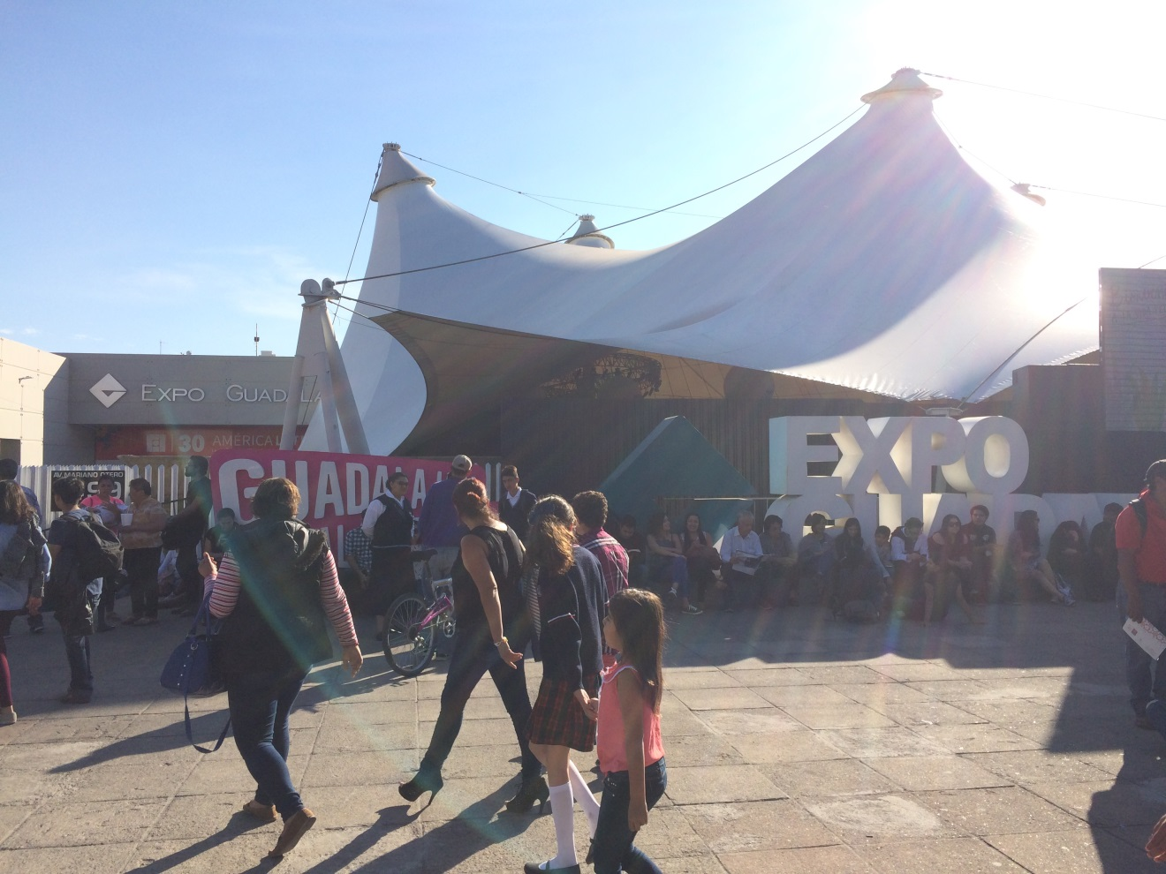
The Guadalajara International Book Fair!
Notes:
Who’s heard of it?
Who’s been?

Slide 9
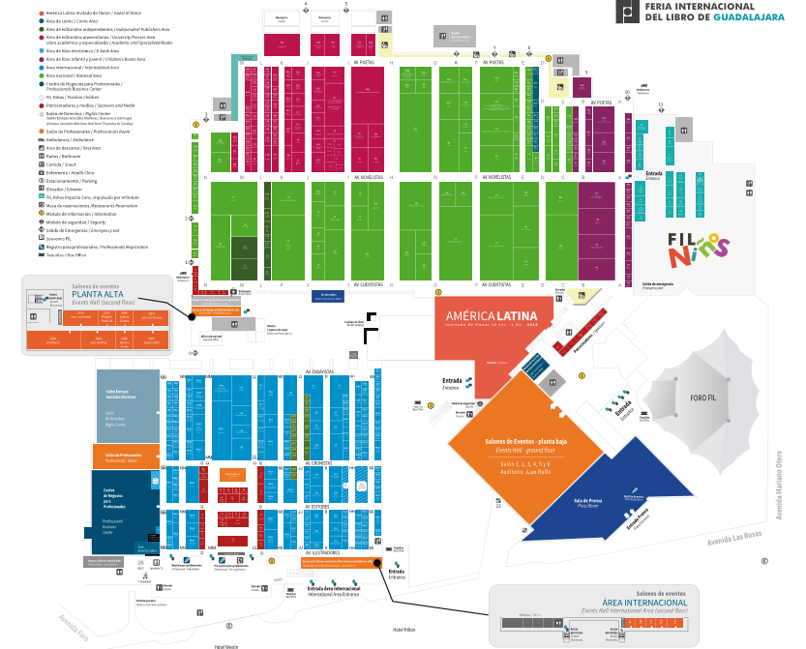
FIL: The Basics
Biggest Spanish-language book fair in the world
  2016 was 30th anniversary
  9 days (and nights!) long
Book professionals from all over the world
  Authors, literary agents, librarians, booksellers and of course publishers
  More than 2,042 publishing houses from 47 countries
  300,000+ titles
  1,500+ librarians from Latin America attend
“Over 800,821” visitors in 2016

Slide 10
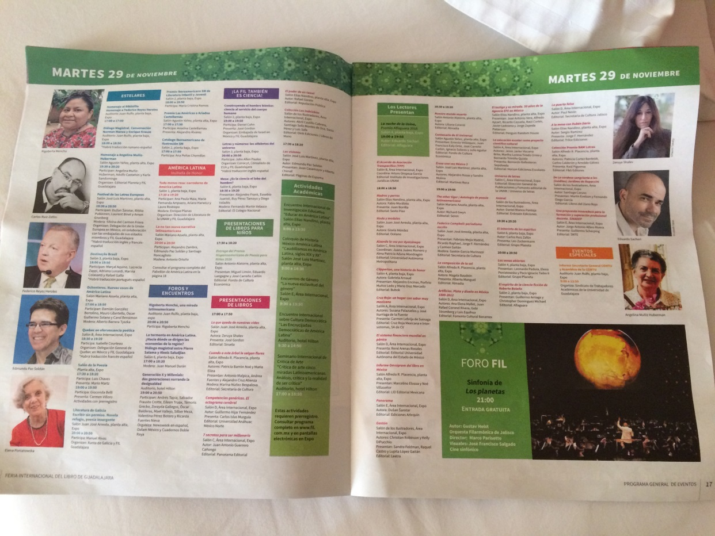
FIL: The Basics
Massive literary arts festival and cultural event
  Music, theater, workshops, performances, art, author talks, lectures
  Day and night
  FIL Niños
These are just some of the events on Tuesday

Slide 11
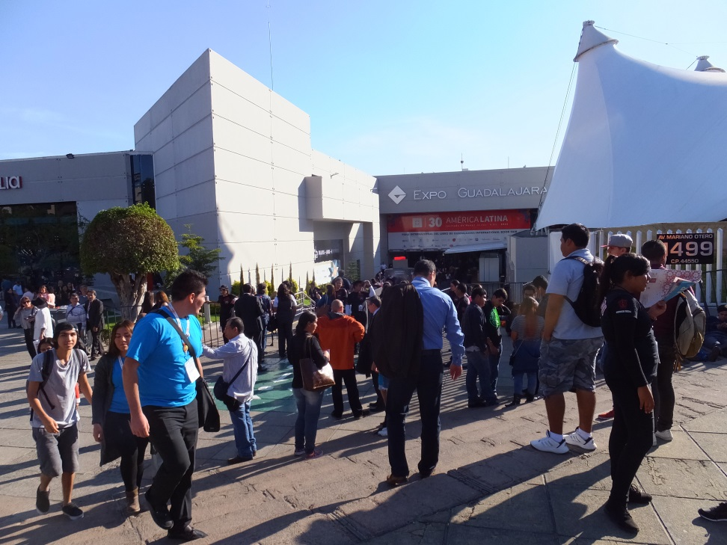
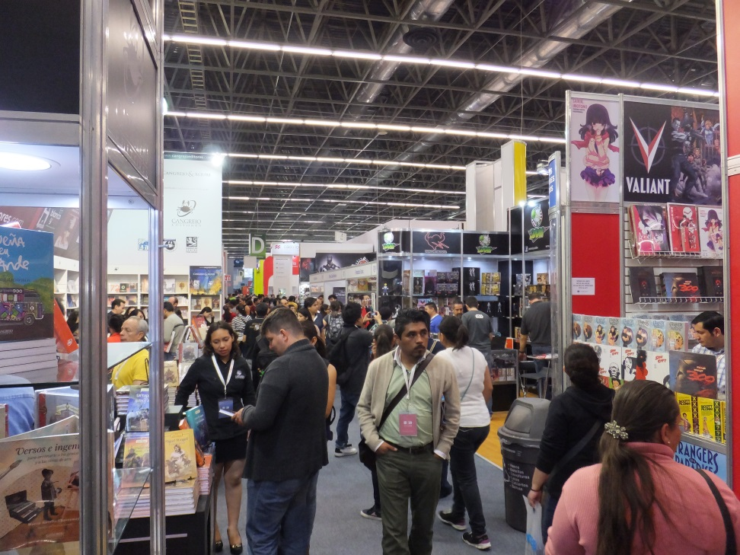
Well over 800,000* visitors
“Over 800,821” visitors in 2016

Slide 12
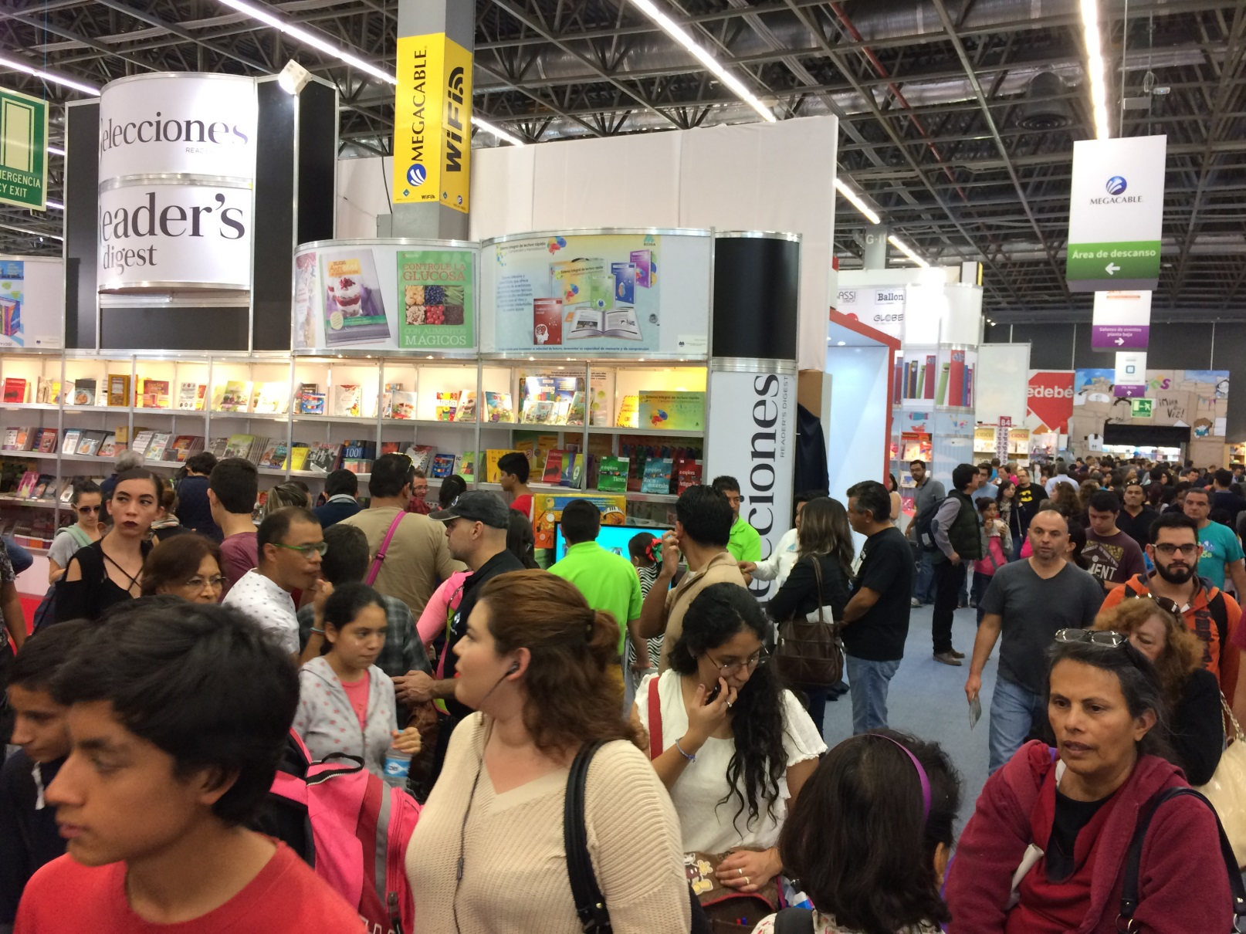
It’s hard to get things done during the public days!

Slide 13
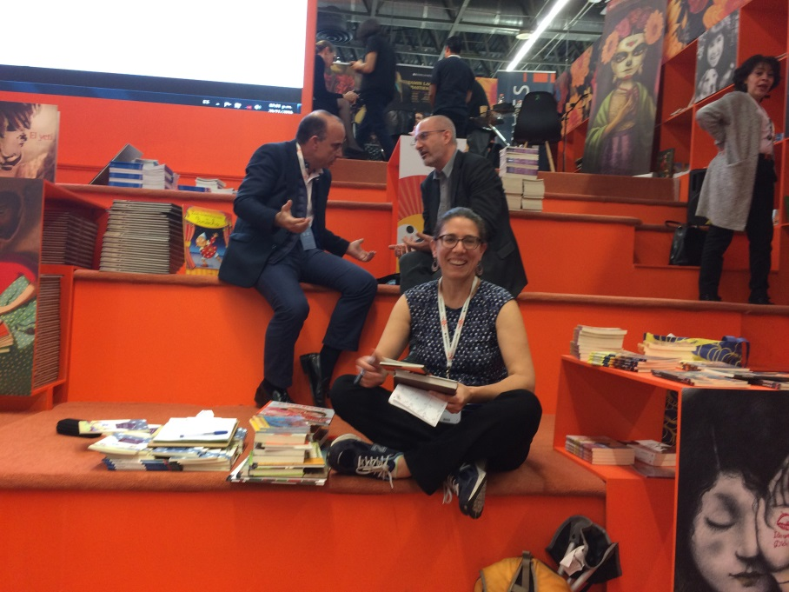
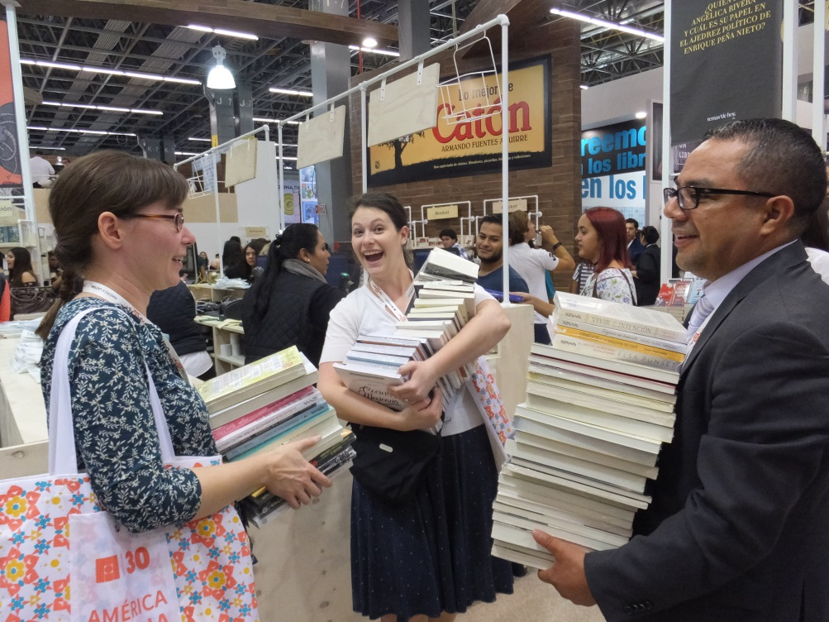
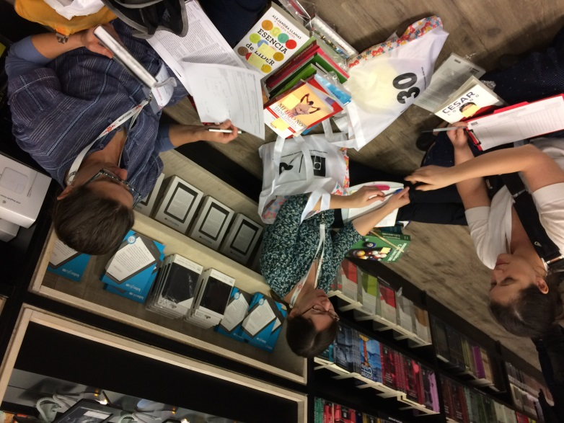
The Professional Days
Monday, Tuesday, & Wednesday
Only registered book professionals
Looong days
Hydrate & wear good shoes…
Notes:
Christina from Beaverton.
Lauren from Tualatin.

Slide 14
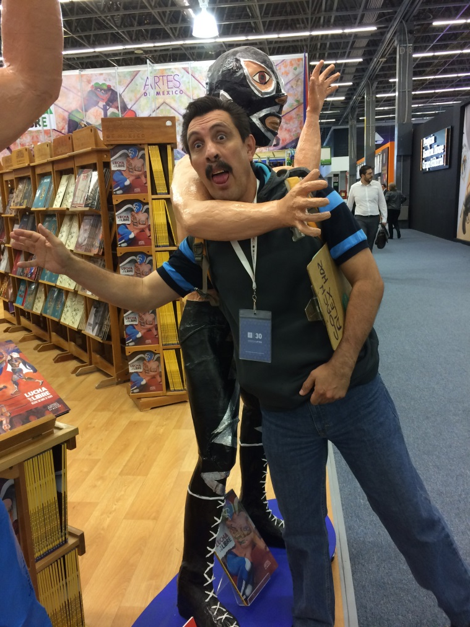
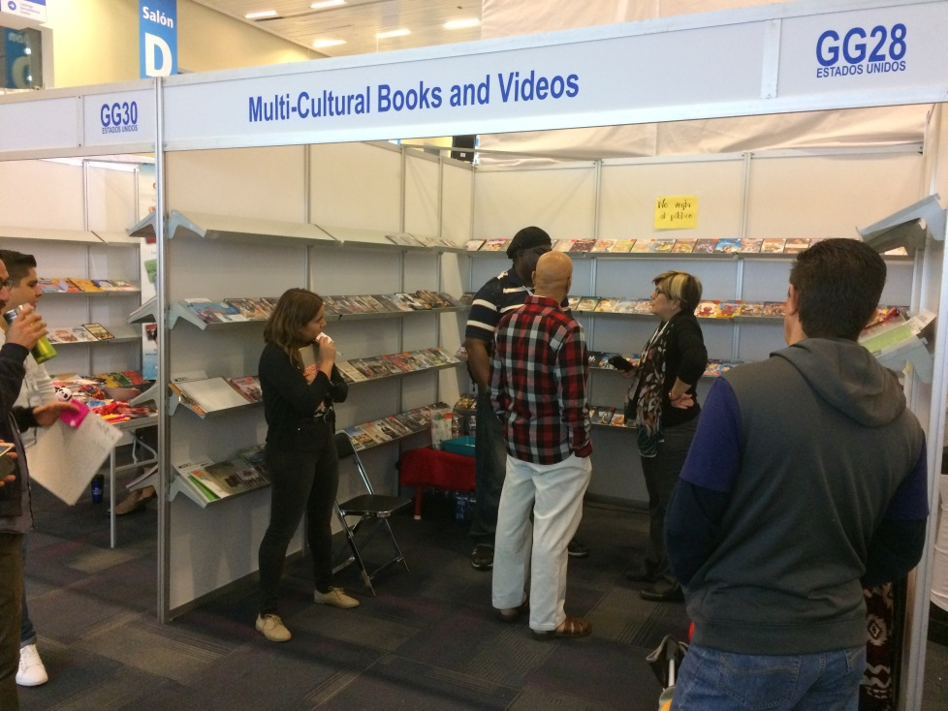
Working with a vendor
Purchasing & shipping
Helpful assistant
Sticky note system

Slide 15
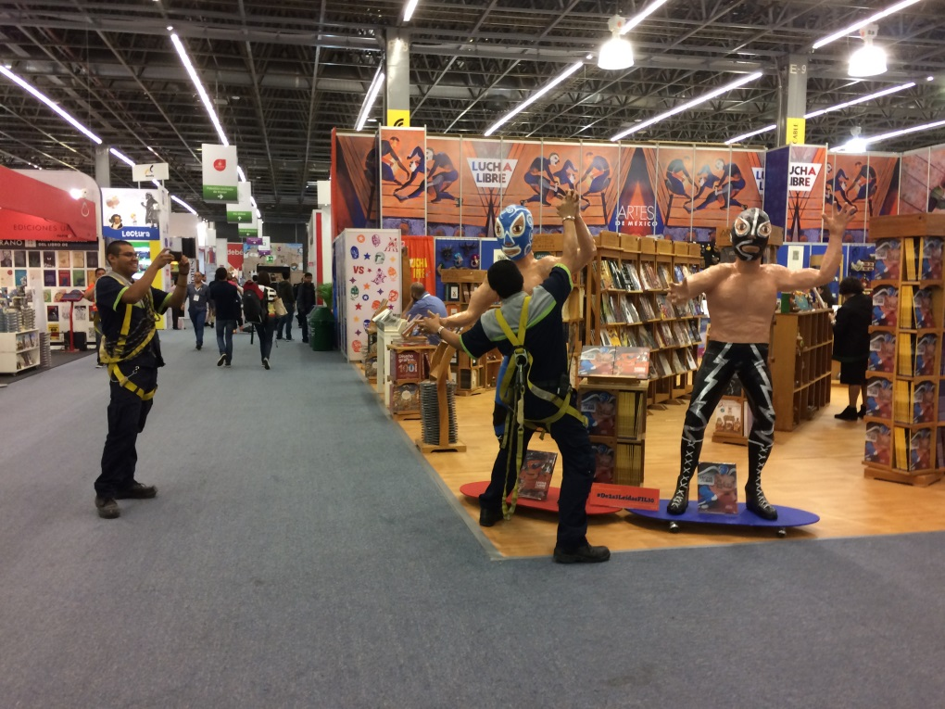
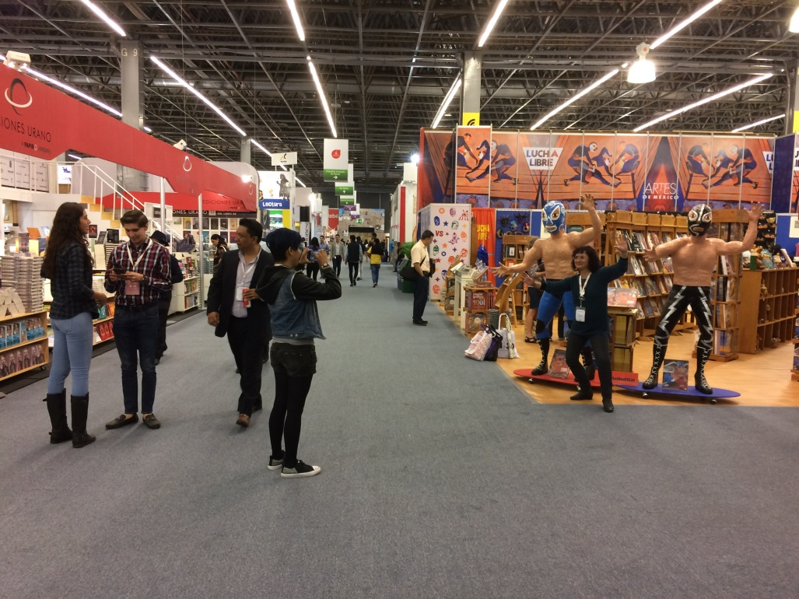
(To be fair, no one can resist the luchadores)

Slide 16
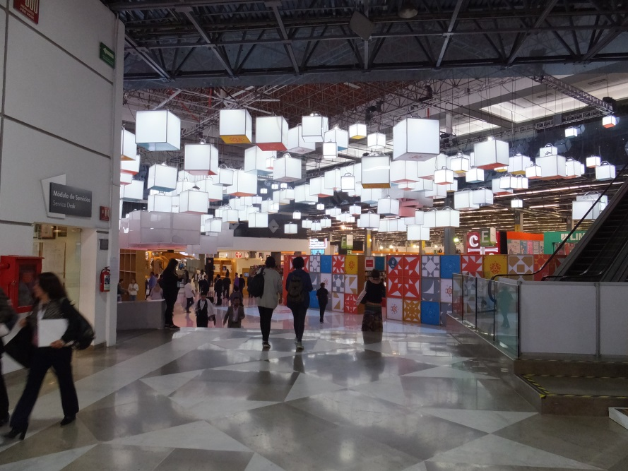
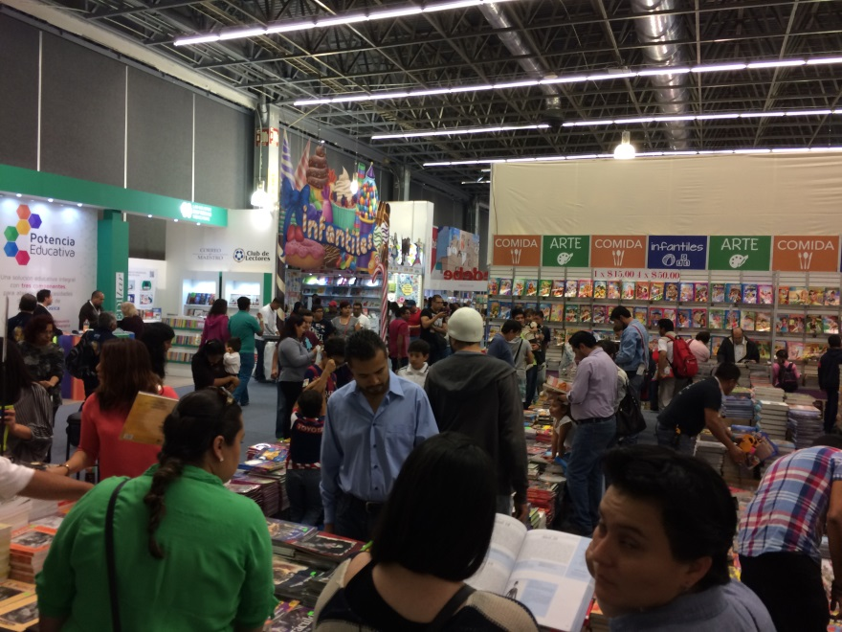
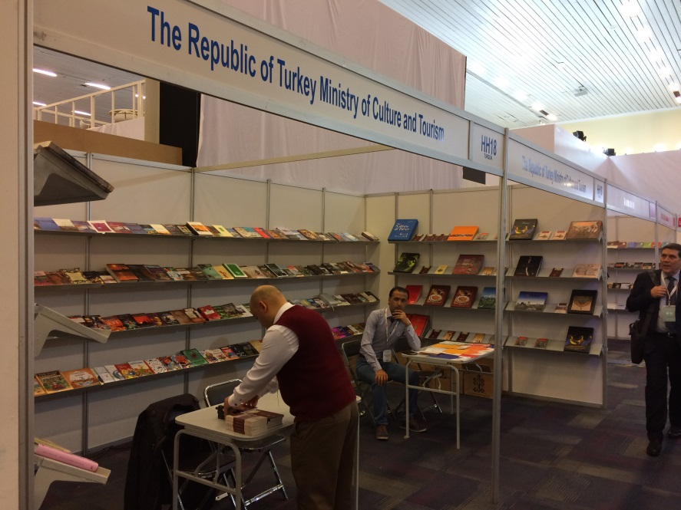
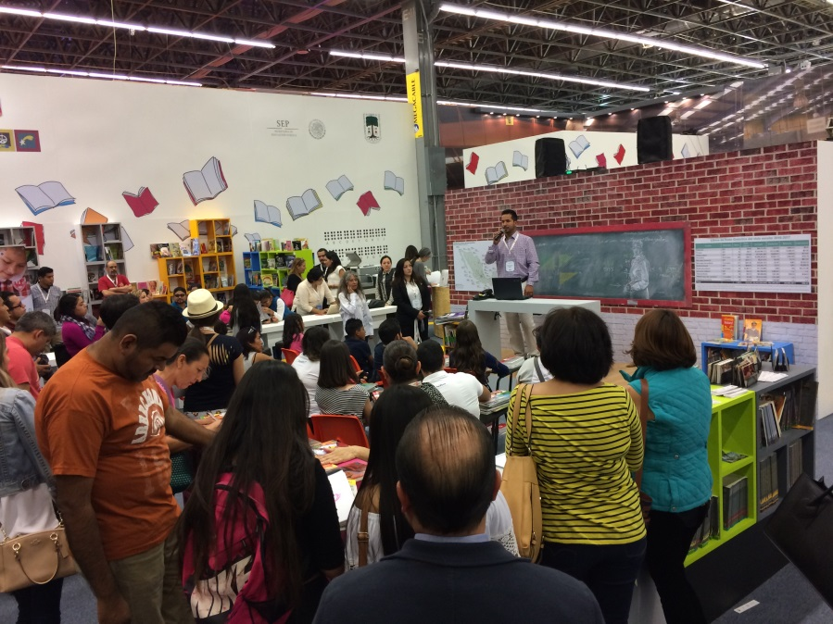

Slide 17
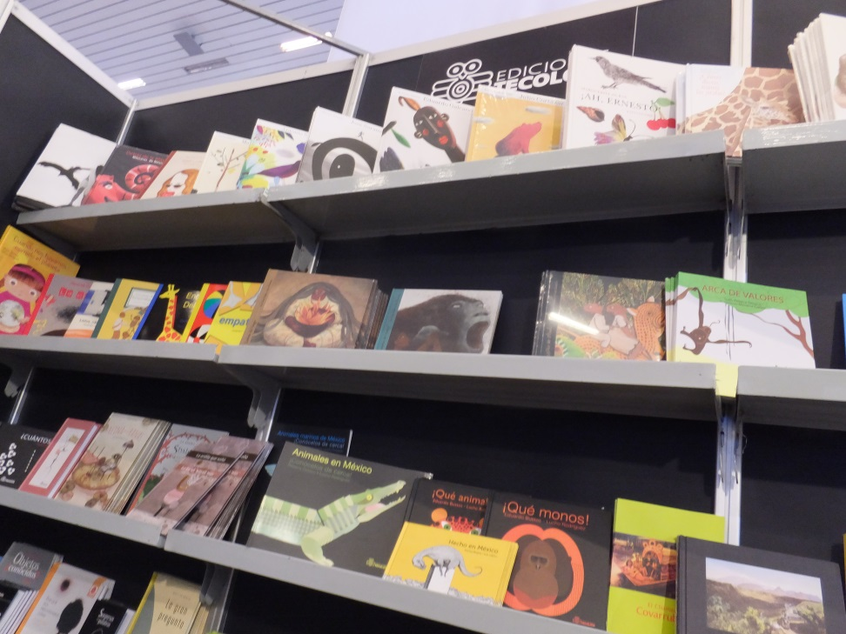
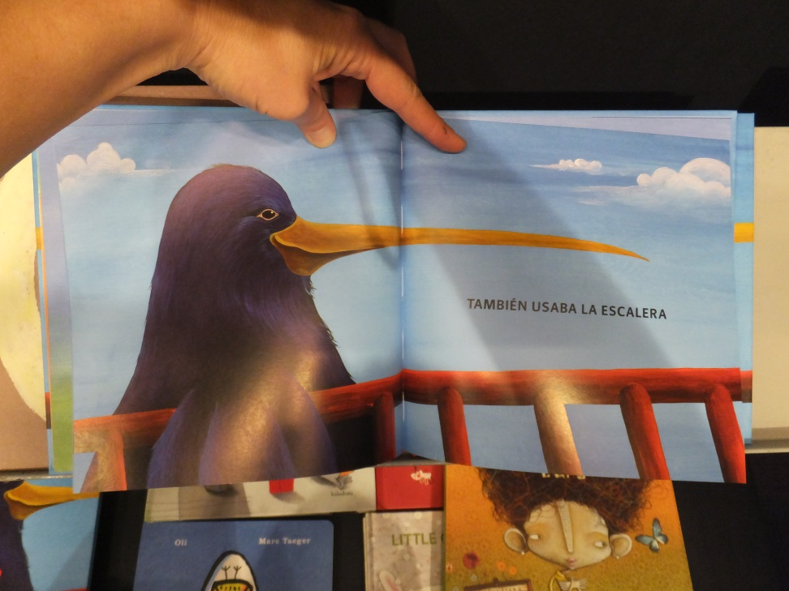
Books books books!

Slide 18
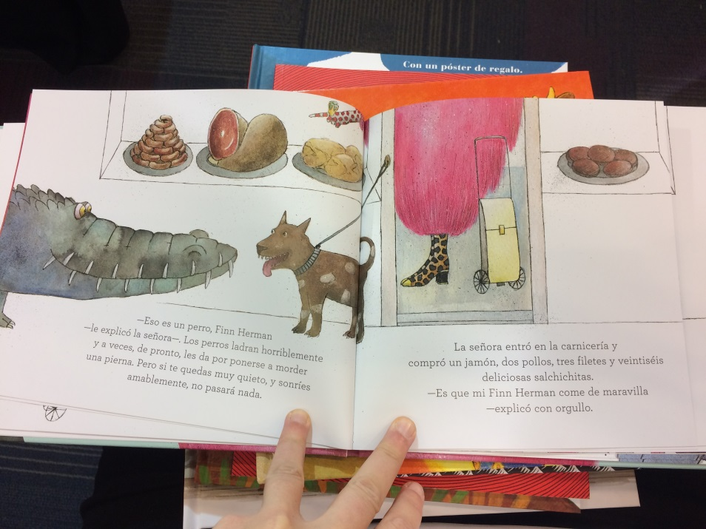
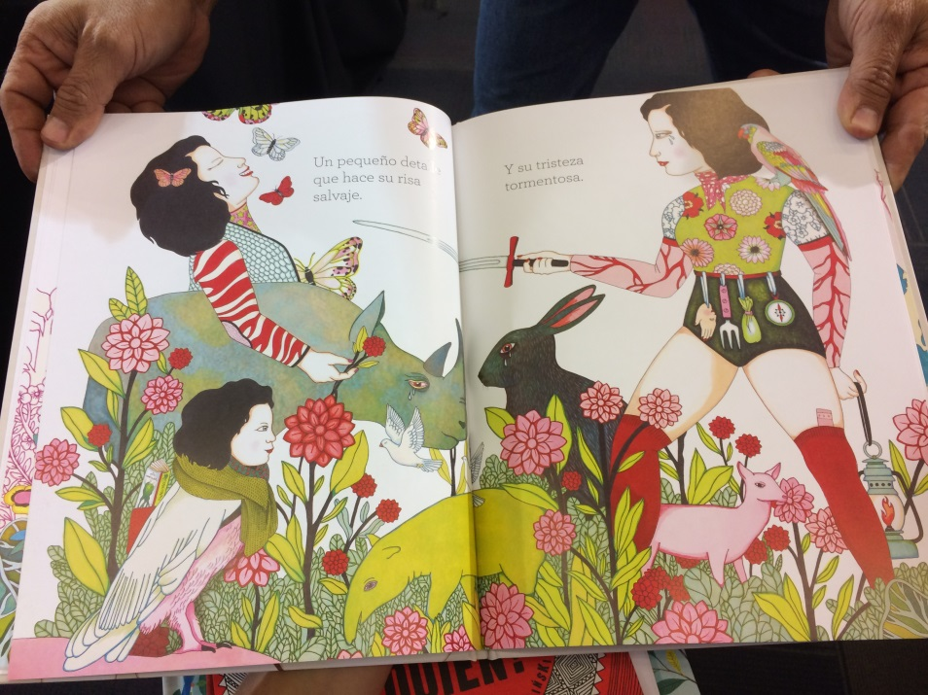
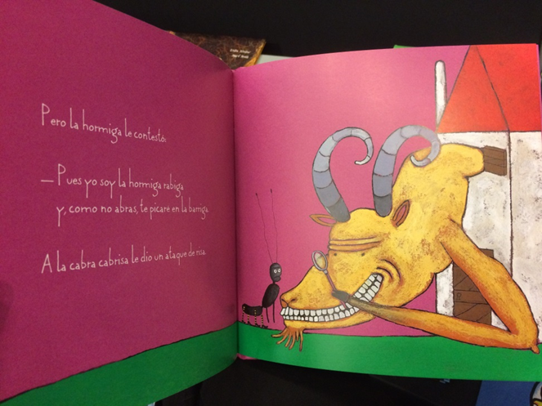
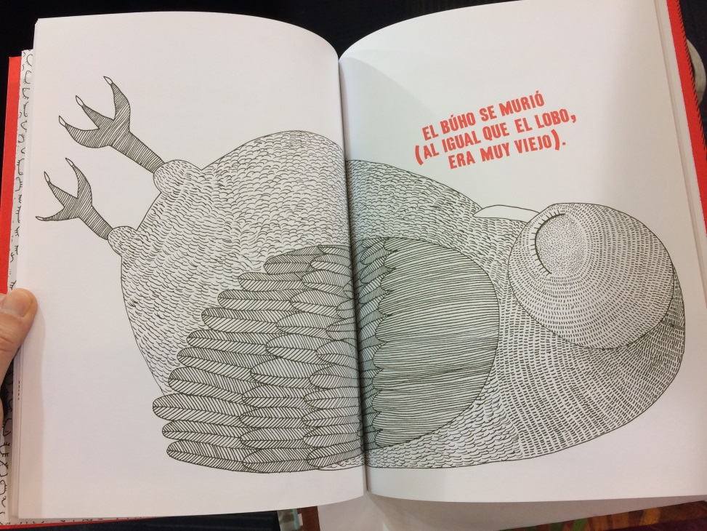

Slide 19
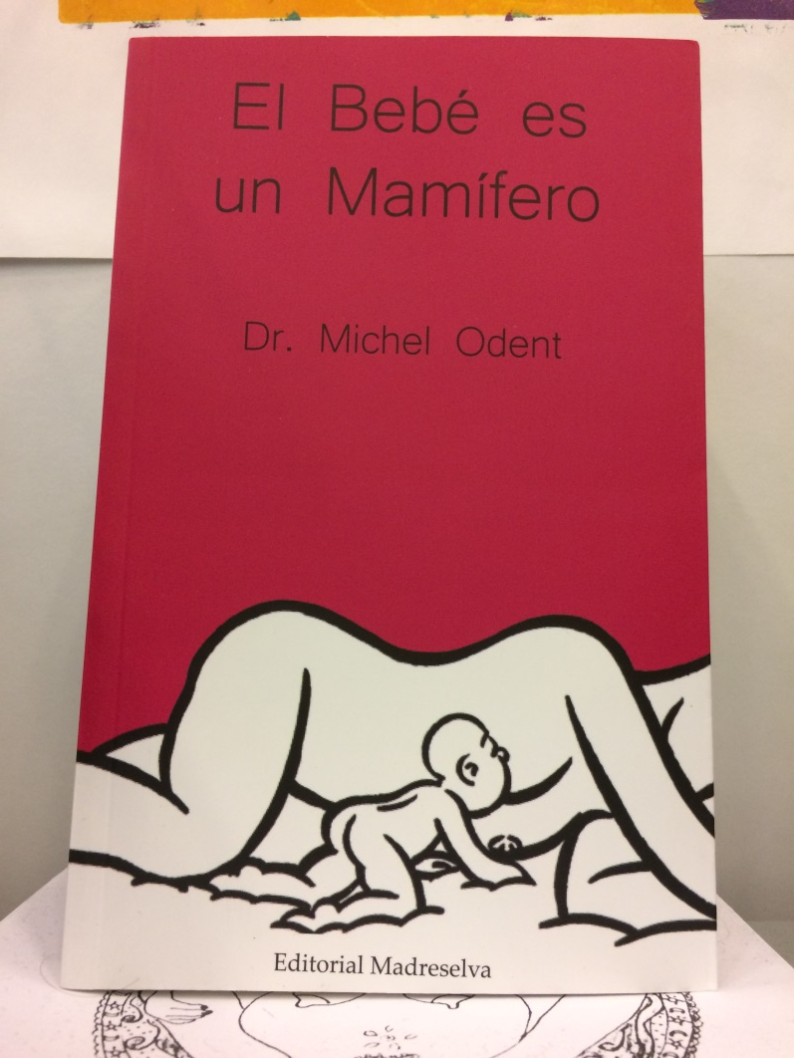
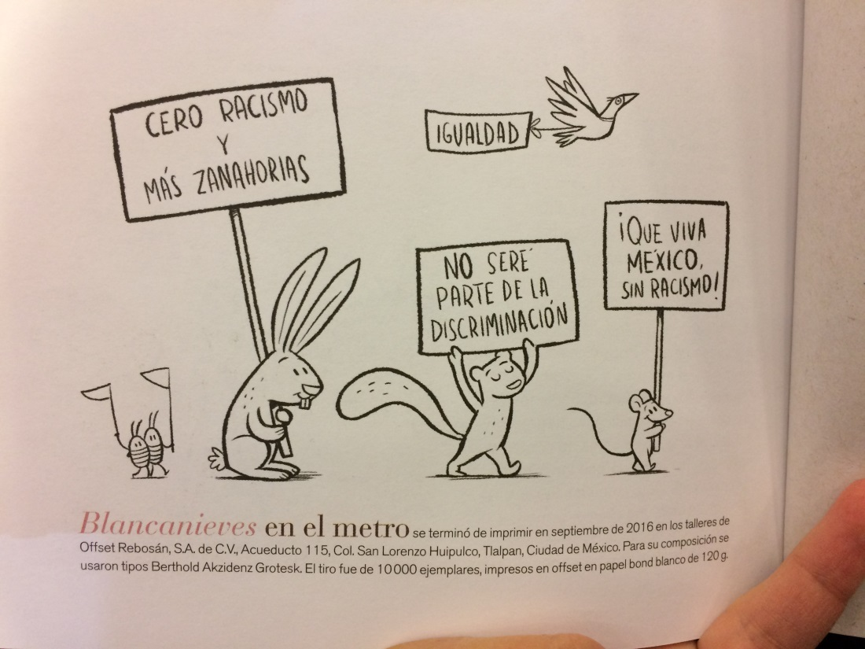
El Bebé es un Mamífero
Cero racismo y más zanahorias
(Zero racism & more carrots)
(A Baby is a Mammal)

Slide 20
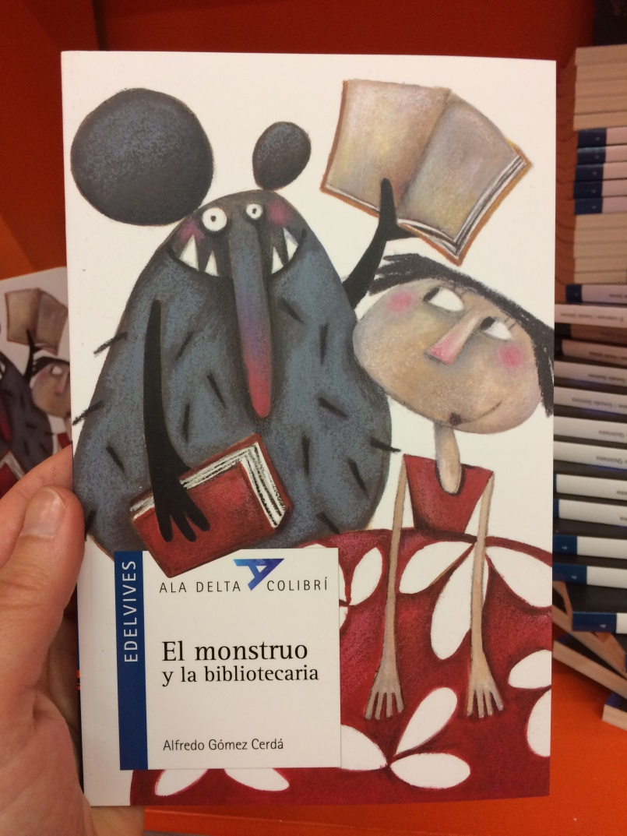
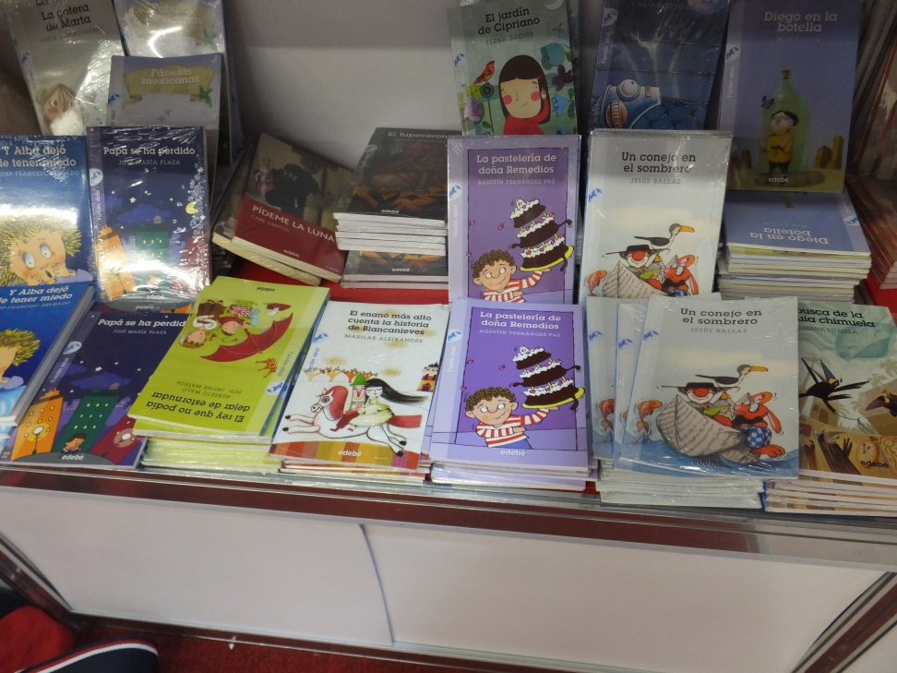
El monstruo y la bibliotecaria
Hard-to-find early readers

Slide 21
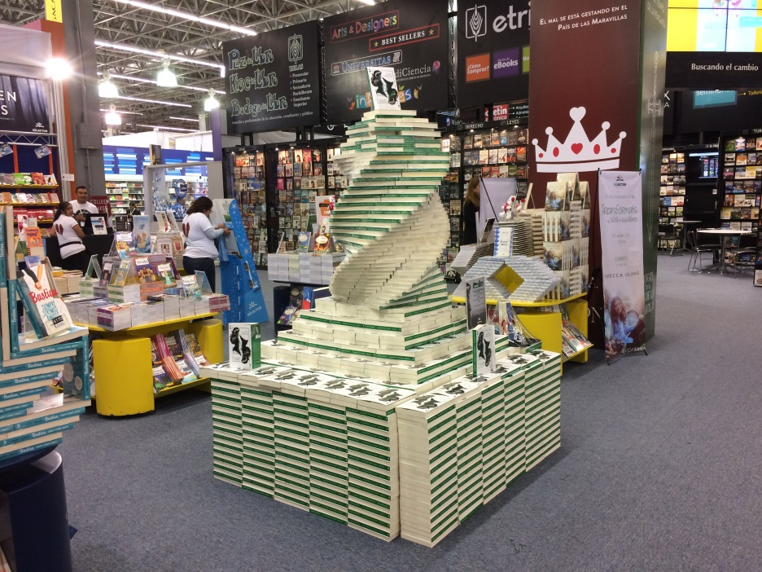
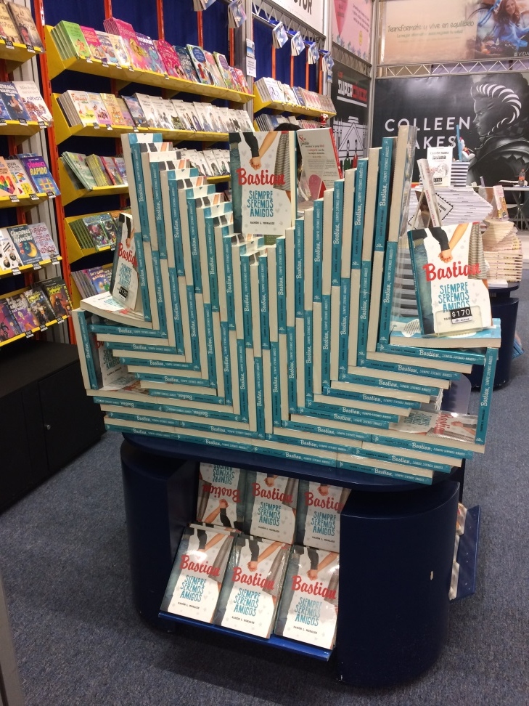
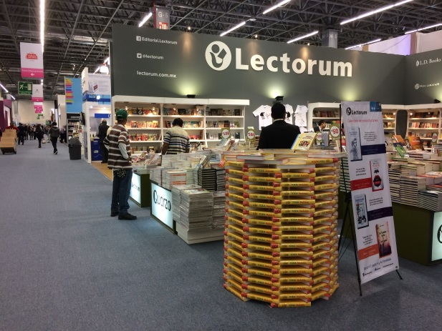
Fancy Book Stacking is a Thing
spiral
chevron

Slide 22
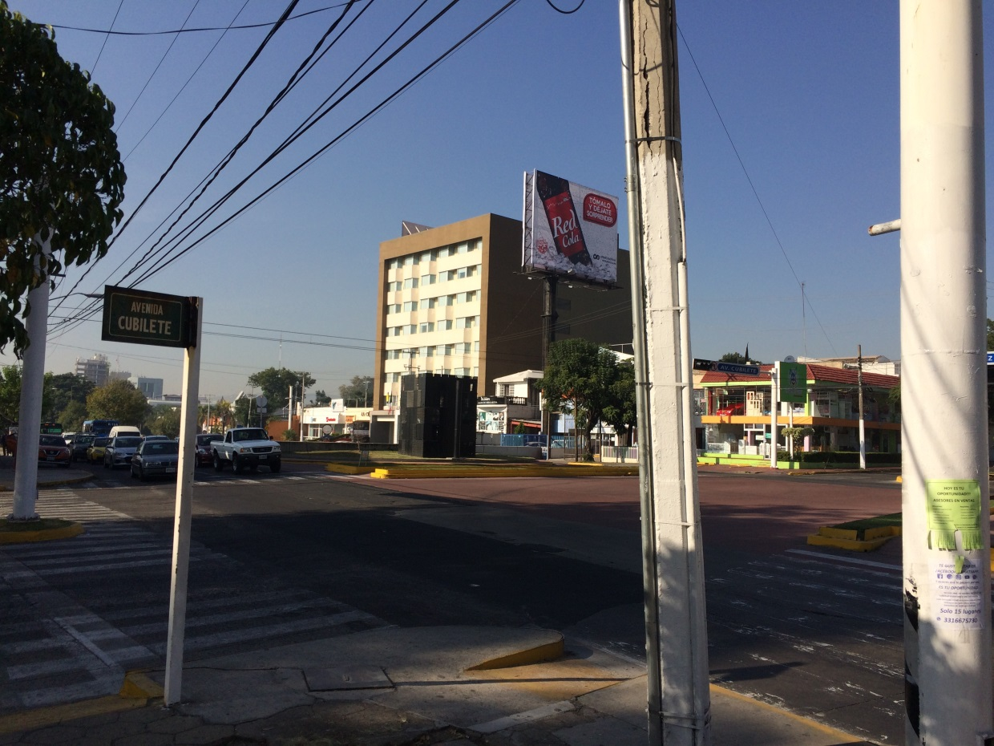
Surprisingly Affordable:
The ALA-FIL Free Pass Program
A long-standing partnership: since 1999
3 (or 6) nights at the Hotel Guadalajara Plaza López Mateos
3 (or 6) continental breakfasts
FIL Registration, courtesy of FIL
$100 toward the cost of airfare, courtesy of ALA
Notes:
Hotel: *6 nights if you share a room with a colleague who is also part of the program
Attendees pay for the remaining airfare, ground transportation, meals, and other incidental costs.
For reference, round-trip PDX to Guadalajara in 2016 and 2017 so far: $350
Taxi from airport: about $10

Slide 23
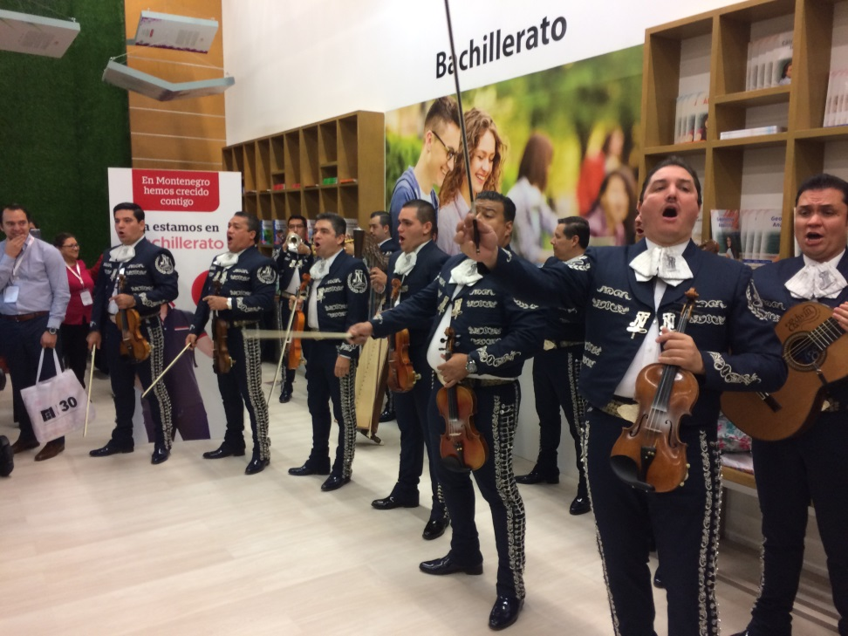
But wait, there’s more!
Also:
FIL offers an additional $100 to the first 100 applicants who submit their airfare confirmation by October 2nd
More info at : http://www.ala.org/offices/iro/awardsactivities/guadalajarabook
Occasional free food…

Slide 24
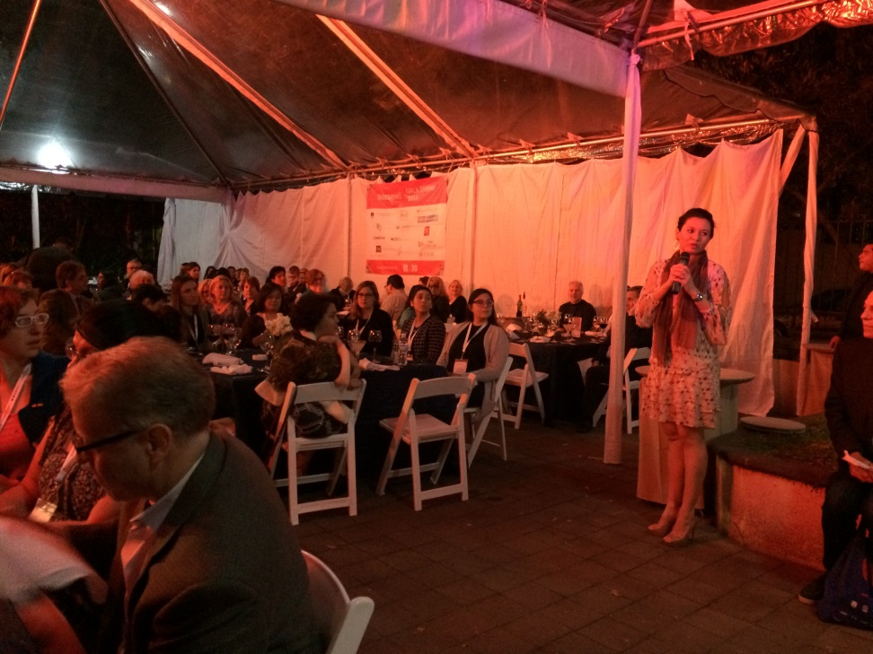
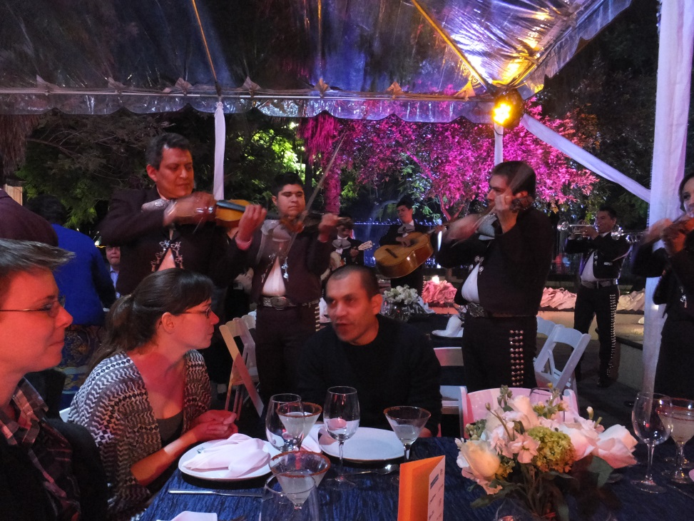
ALA Gala Publisher Dinner
Publisher presentations
(Mariachis: festive, but
hamper conversation)

Slide 25
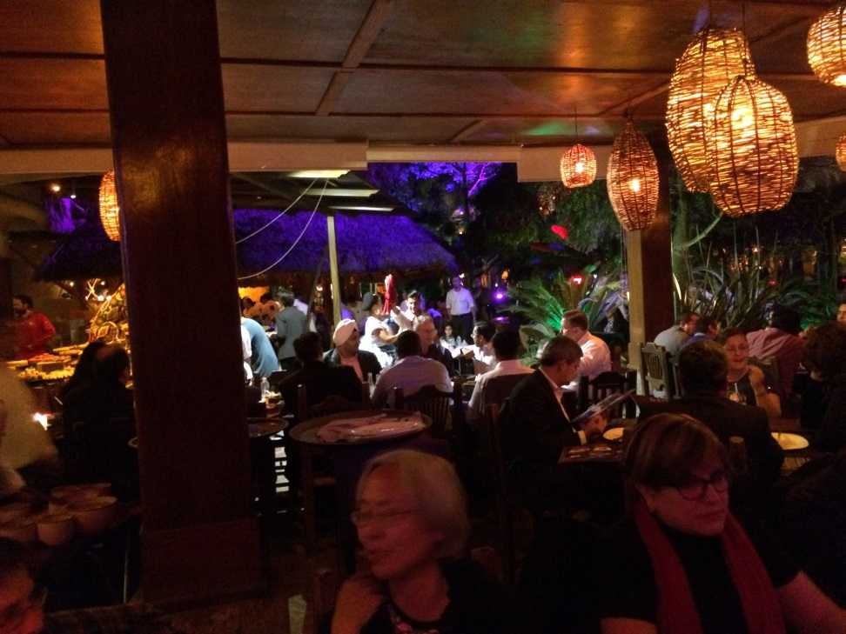
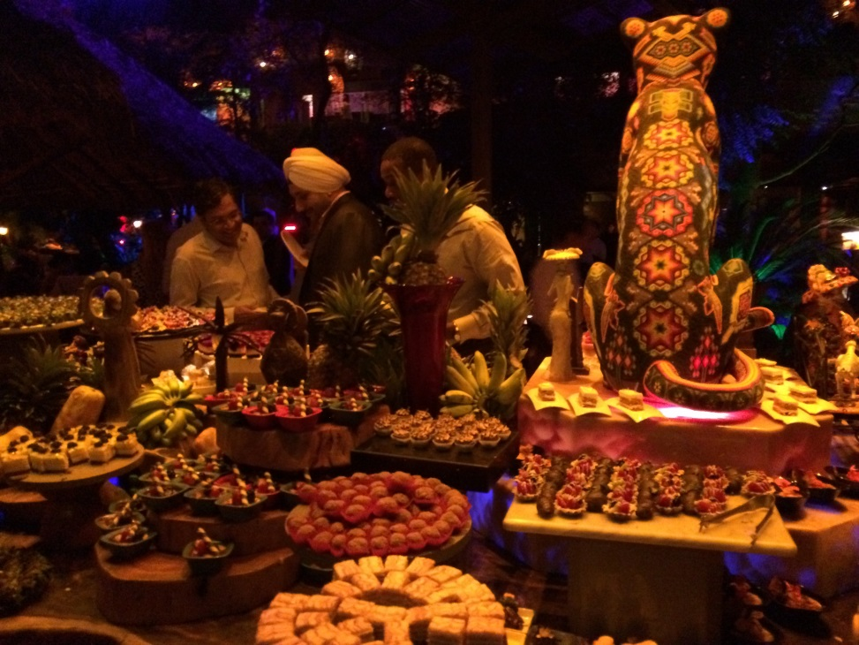
Vendor Dinner
MCBV at Santo Coyote
Huichol jaguar
oversees Dessert Island

Slide 26
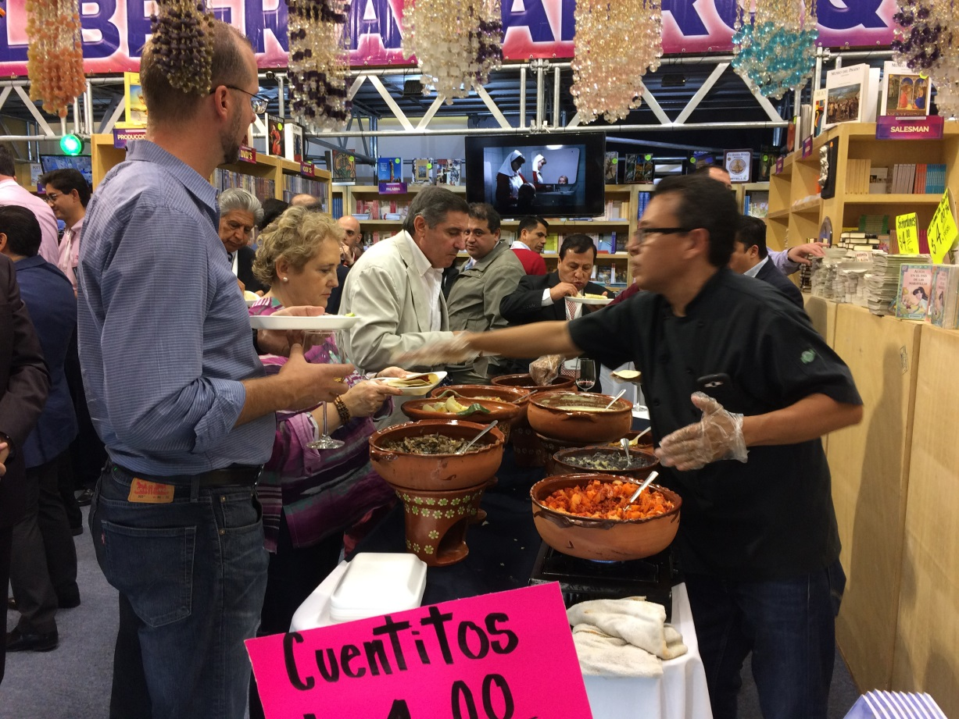
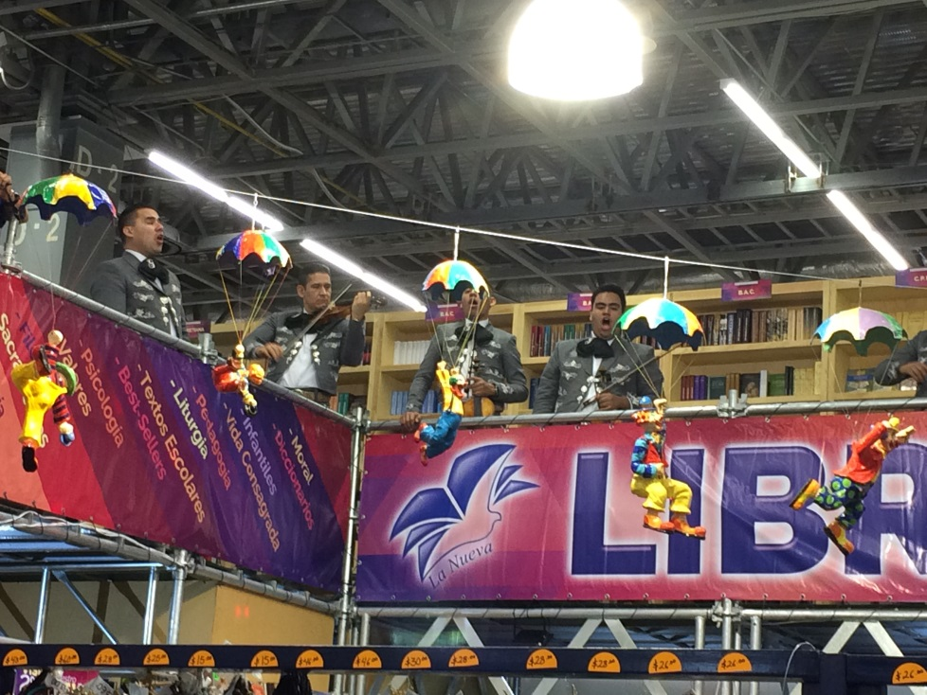
Some afternoons, publishers have parties…
A party to which I was not invited
…with mariachis

Slide 27
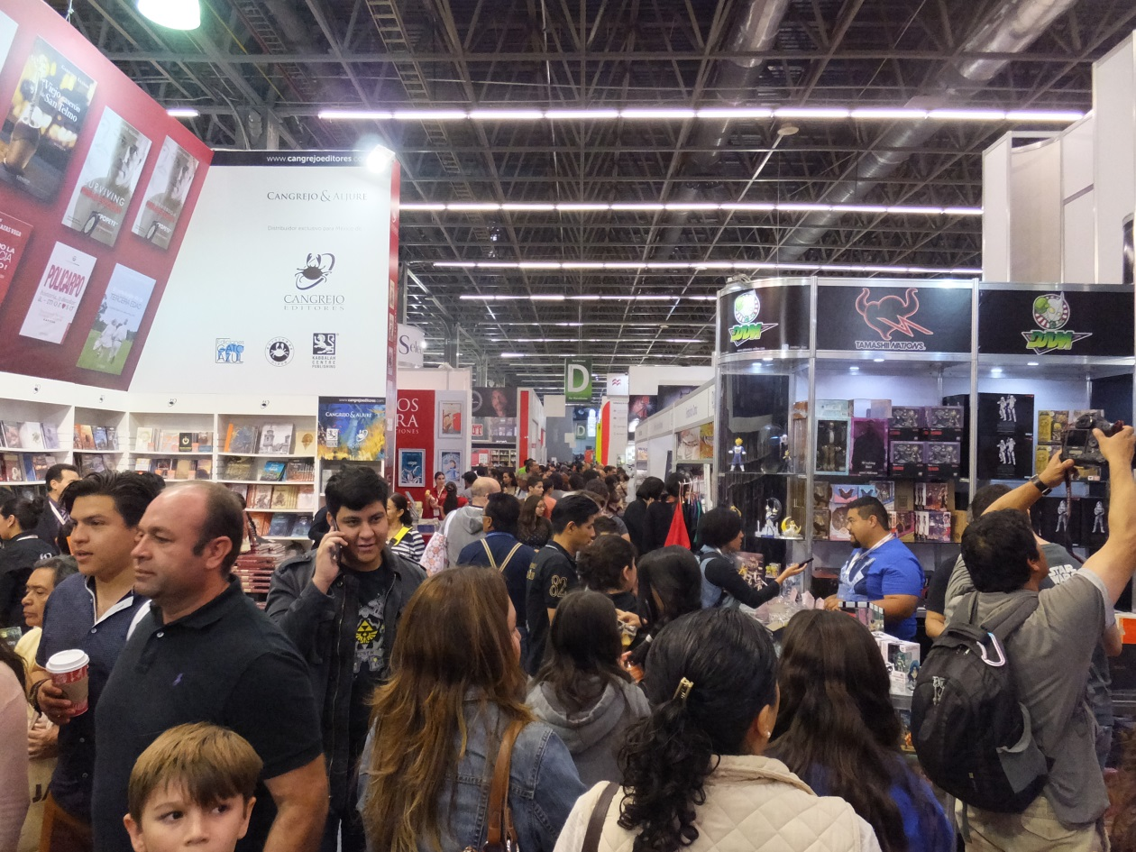
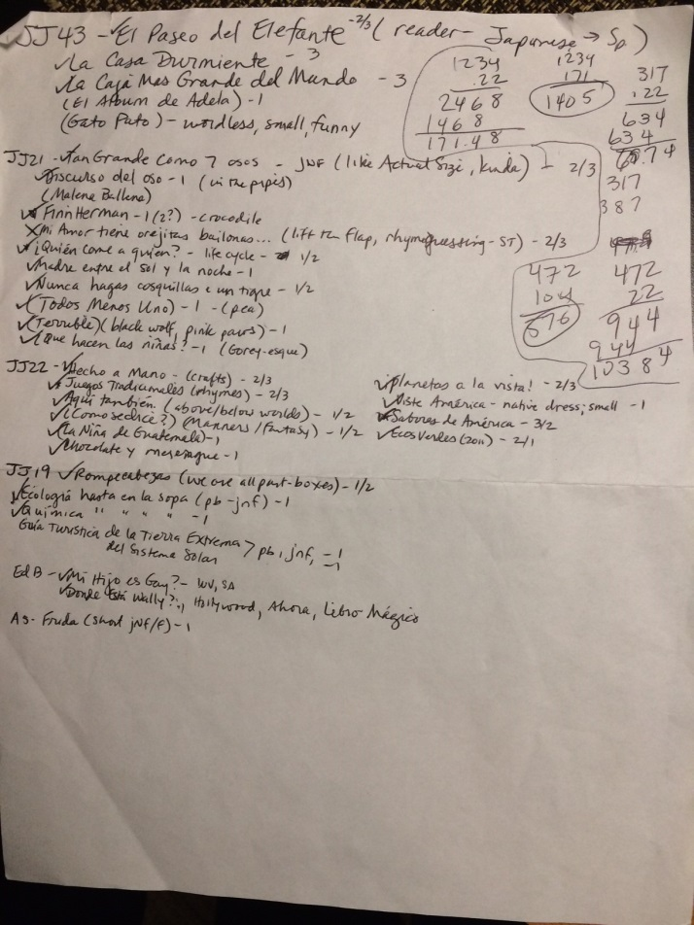
No kidding, though, it’s hard work

Slide 28
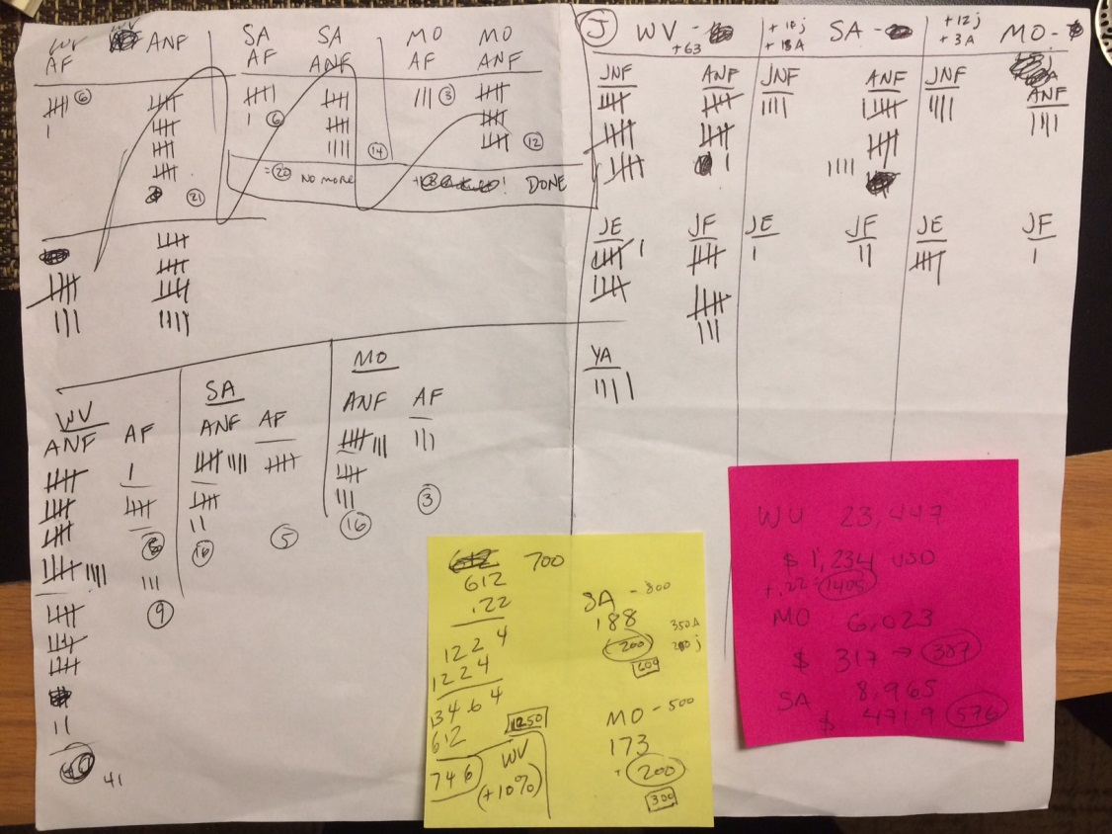
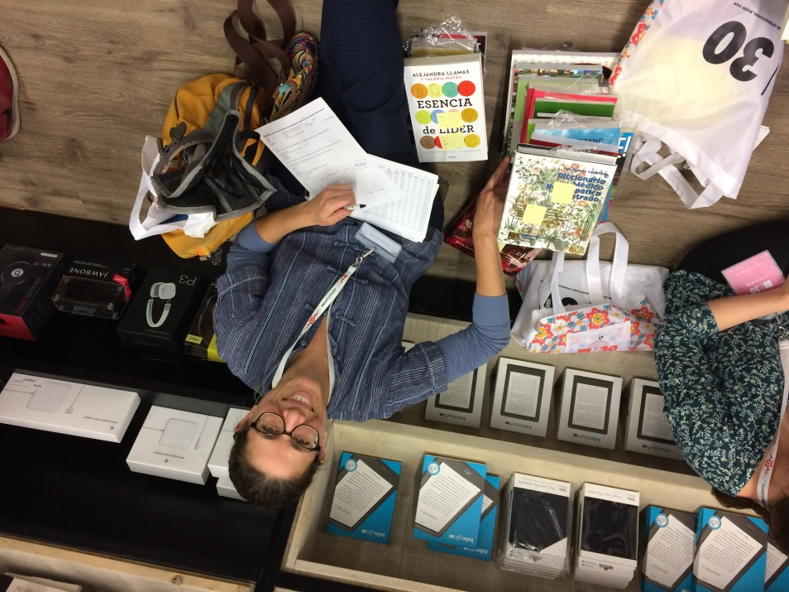
Searching, sorting, stacking, unwrapping, calculating, recalculating, walking, walking, walking…

Slide 29
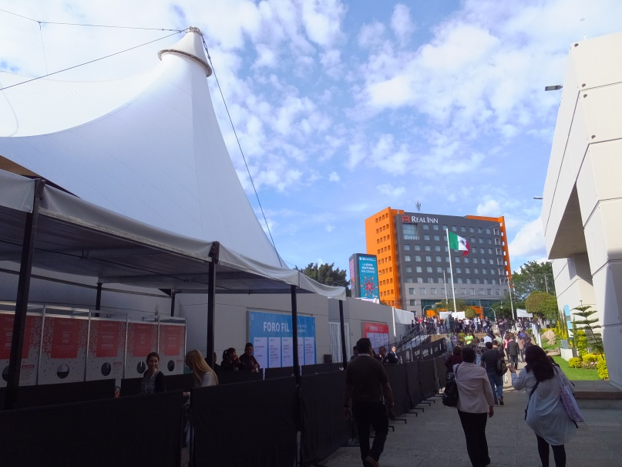
Back to the grant. So, what’s the plan?
The Advisory Council
Diverse representation: state geographic region, library size, service population of Spanish speakers
Help figure out all the logistics
Guinea pigs: Serve as test subjects this first trial year
Notes:
Meeting timeline: FIL; snow

Slide 30
Logistics: the Participants (I)
10 libraries
  Regional diversity, other diversity
  This first year: five LINCC libraries (LINCC is the fiscal agent) + 5 others
  Trial year: LfO Council Members
  Future years: any Oregon public library, selected by committee
1. Milton-Freewater
2. Newport
3. Driftwood
4. Klamath
5. Wilsonville
6. Oregon City
7. LINCC #3
8. LINCC #4
9. LINCC #5
10. Oregon Trail Lib District
Notes:
Council Guinea Pigs will speak soon

Slide 31
Logistics: the Participants (II)
Ten libraries annually (depending on the experience this trial year)
Annual application to participate:
  Library data
  Outreach plan
  Purchase request
  Reports & feedback afterward
Ante: $200 - toward travel kitty
The “Travelers”
3 staff representatives
At least one seasoned LfO Traveler and one newbie
Buy for the 10 libraries
Notes:
Council Guinea Pigs will speak soon

Slide 32
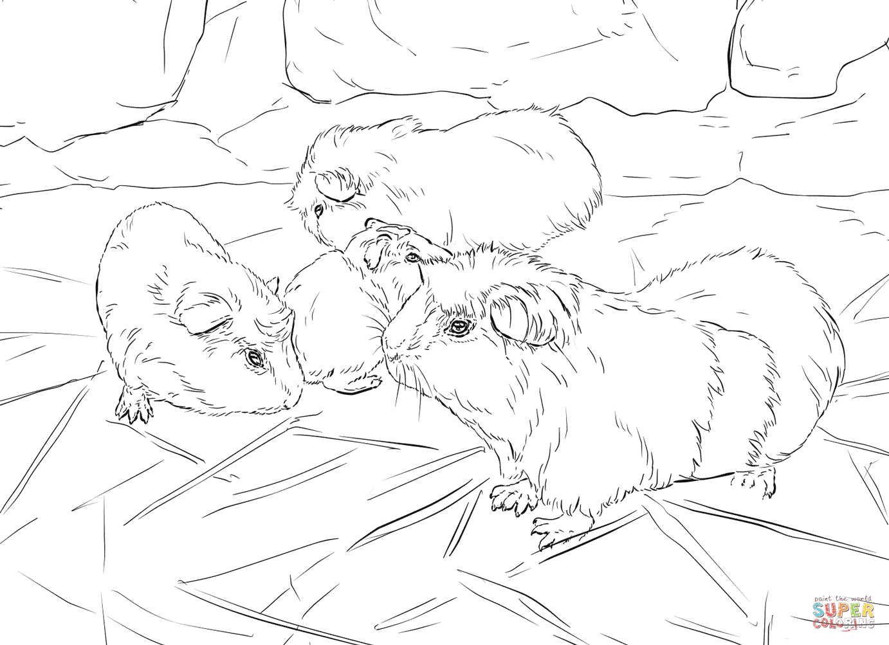
What’s Next?
FIL 2017
Test the process, forms, & procedures
Report at OLA
pre/conference
next year (2018)
Lay the groundwork
for the project’s administration going forward

Slide 33
LfO administration going forward
OLA: assume Libros for Oregon oversight?
Eg. committee comprising a combination of members of REFORMA, Outreach Roundtable, CSD
REFORMA is willing to provide half the committee membership, say 4 people, and much of the guidance
  I’m a member of REFORMA, and so are several members of the Advisory Council, and we can guide the first year(s) of transition to committee administration

Slide 34
What would administration entail?
A Libros for Oregon committee would:
Solicit and review annual applications and select participants
  and select the three Travelers annually
Support participants in meeting outreach requirements
  outreach plans and activities, outcome-based reports
Collect, disburse and oversee funds
  $200 from each of 10 participating libraries annually, forming a kitty that pays for the three Travelers to travel to the FIL (any overage to be banked)

Slide 35
What would administration entail?
A Libros for Oregon committee would also:
Maintain the external LfO website
  And keep the library community aware of the website and LfO in general
Publish the annual FIL selection/purchase list (on the LfO website)
  Possibly recruit, train and work with an MLIS grad student to annotate the list for US availability
Serve as contact point with the vendor/s (or devise another system)
Solicit and publish (on the website) participants’ feedback/outreach reports/stories
Possibly coordinate LfO presentations in professional fora
Generally be clearinghouse for all LfO questions & wrangling

Slide 36
What would administration entail?
Makeup of a Libros for Oregon committee:
8 members
  4 from REFORMA; others perhaps from CSD, Outreach, or at-large members
Both two-year and one-year terms
  To support both continuity and the chance for many people to participate/learn
  REFORMA is willing to be the lead/coordinating body
  Grant work in the coming year can include figuring out the likely breakdown of tasks and overall template

Slide 37
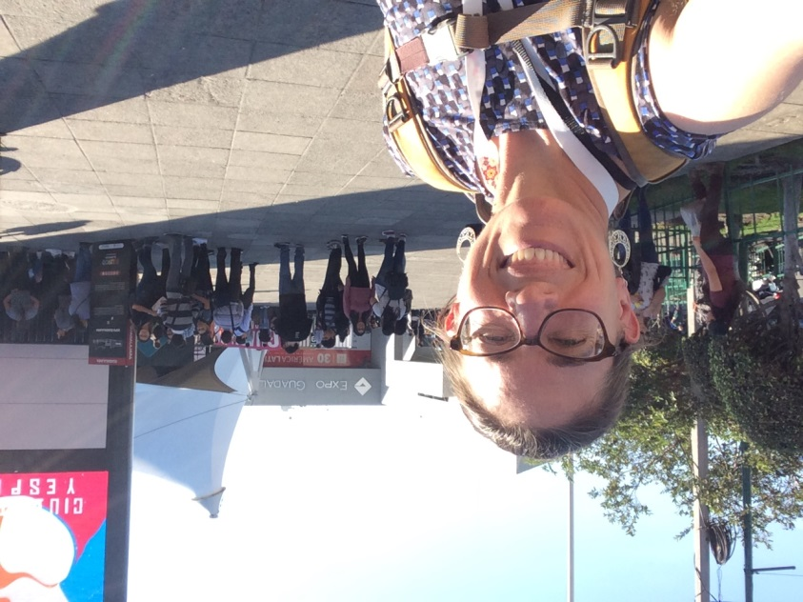
Contact info
Deborah Gitlitz
Outreach Librarian | Bibliotecaria Comunitaria
Wilsonville Public Library
503-570-1582
gitlitz@wilsonvillelibrary.org
(Libros for Oregon website coming soon!)

